Slide 1
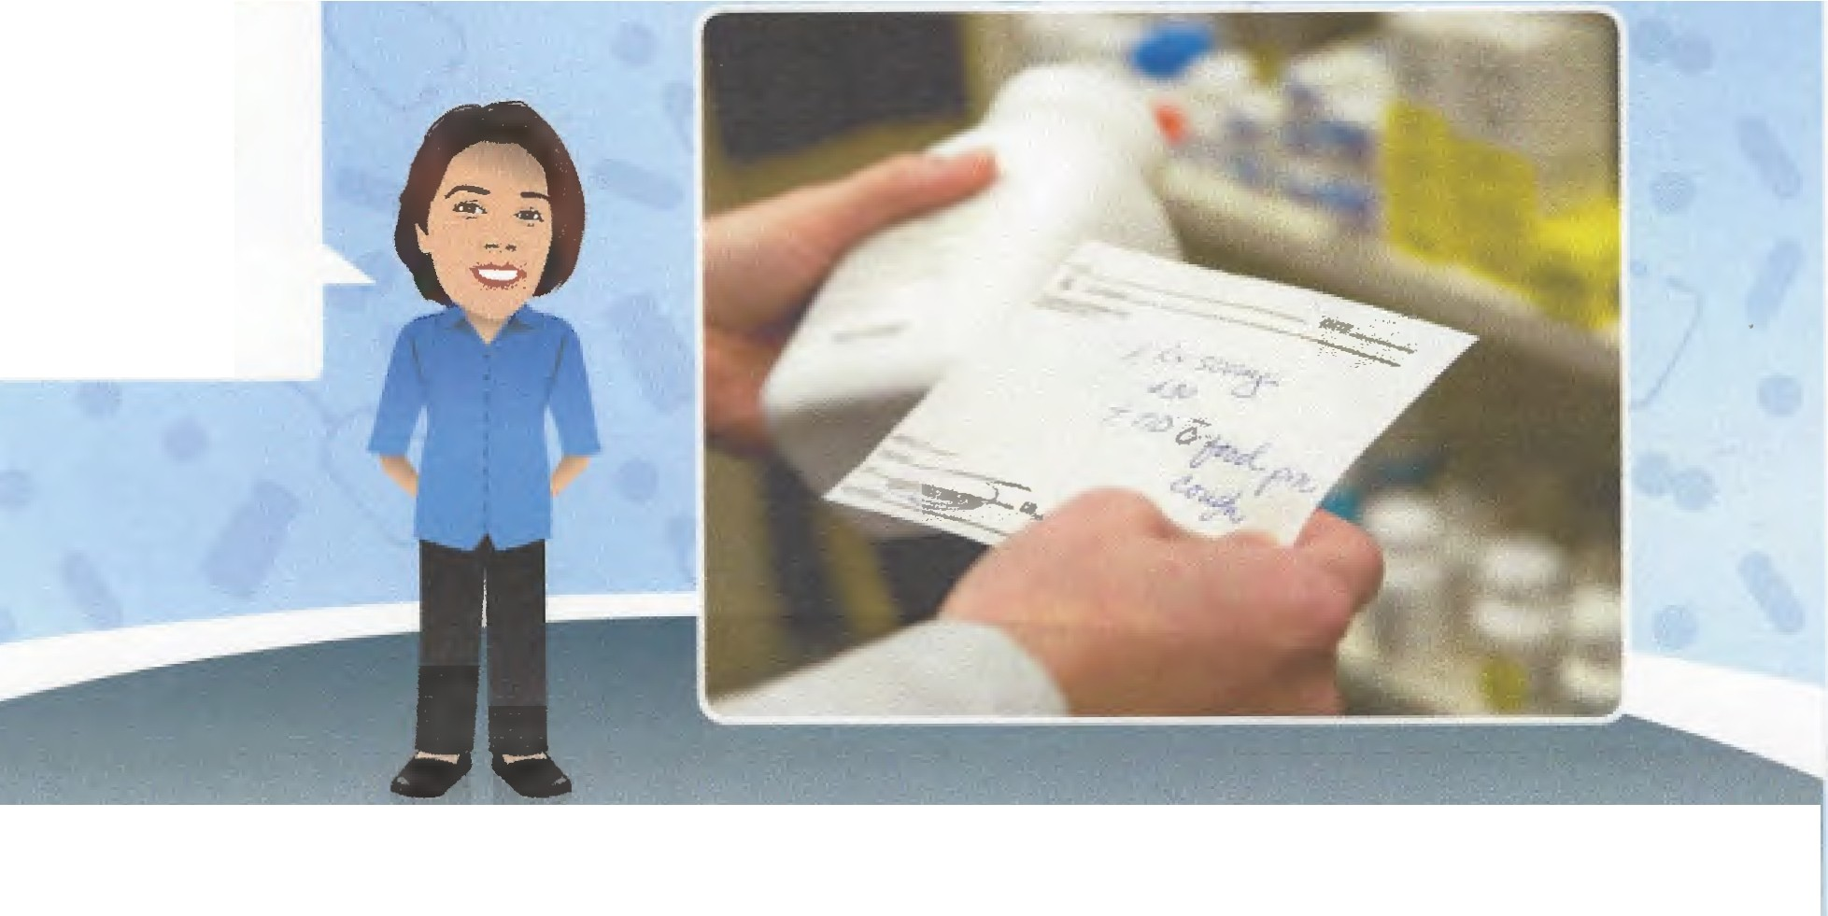
You must keep accurate and up
to date records of medication!
Medications are the property of the person for whom they are prescribed, howeve,rproviders are required to keep records of medicine used, ensure that medication reviews are taking place regularly and that a record is kept in the person's care plan.

Slide 2
Recording and Reporting on the Use of Medication
All records should be clear, legible, in black ink and signed.
Each provider should have in place policies and procedures which describe:
Ordering of medicines (where relevant).
Receipt of medicines (where relevant).
Pro. v | iders | need | to | keep | a | recor
d of th e' inibals an.d fu ll ,sign at ures of all staff that are in any way involved with the care and administration of medication.
Local recording systems must provide an accurate audit trail from prescription to administration or disposal. A
up to date record of current medication prescirbed for each person must be maintained and medicine records should be kept together in one place. All medication records should reference to the originalprescription and not the previous MAR.

Slide 3
Recording and Reporting on the Use of Medication
Measurement:
Medication comes in different strengths.
Always check you have the correct dosage.
Check the medication sheet, label and container.
BACK
To maintain an accurate recording system, everyone must understand how drugs are named, how drugs are measured and what is provided on a medicine label. Click on each of the headings for more infonnation and for further learning and a refresher of previous learning.

Slide 4
Recording and Reporting on the Use of Medication
Naming drugs:
Drugs often have two names.
One is the approved or generic name, the other is the proprietary or brand name.
This can cause confusion, as medication can appear to have changed.
Always check the generic name against the medication sheet.
The medicine has the proprietary or brand name, for example RESTORIL
and an approved or generic name, for example temazepam.
BACK
To maintain an accurate recording system, everyone must understand how drugs are named, how drugs are measured and what is provided on a medicine label. Click on each of the headings for more infonnation and for further learning and arefresher of previous learning.

Slide 5
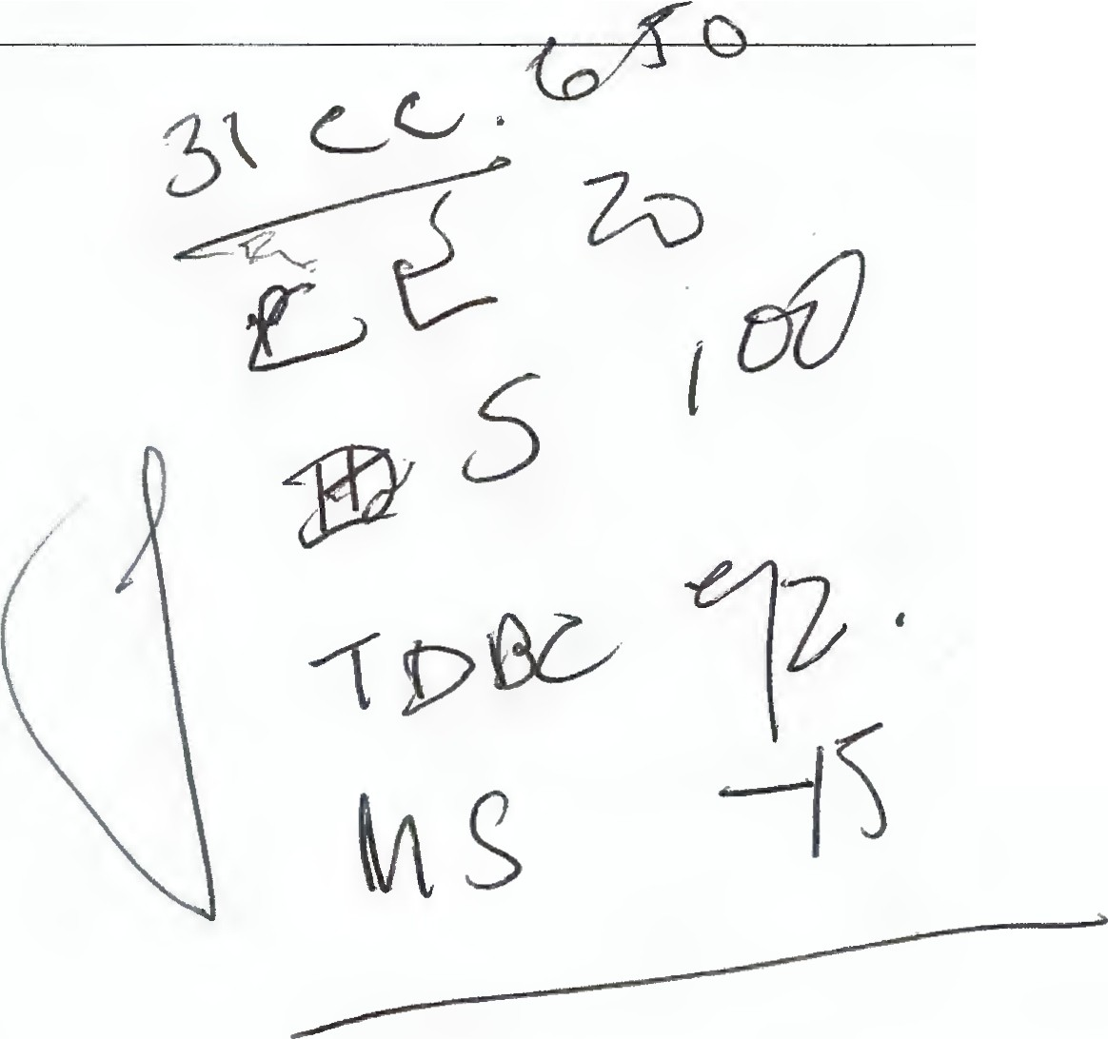
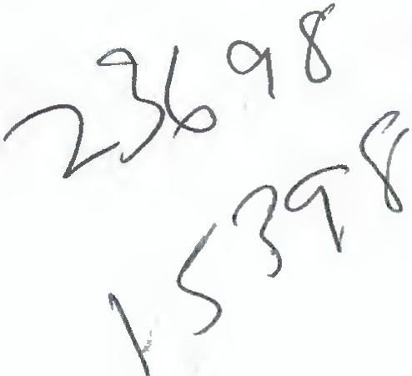
Recording and Reporting on the Useof Medication
What's on the label?
Frank's Chemi t, 54 LONG ROW, NOTTING 21 * AMOXYCILLIN 250MG CAPSULES
ONE to be taken THREE times a day as directed
*Take regularly and complete the course*
MR B CENTRE 16 APR 2005
BACK
To maintain an accurate recording system, everyone must understand how drugs are named, how drugs are measured and what is provided on amedicine label. Click on each of the headings for more information and for further learning and a refresher of previous learning.
J

Slide 6
Recording and Reporting on the Use of Medication
Naming drugs:
Drugs often have two names.
One is the approved or generic name, the other is the proprietary or brand name.
This can cause confusion, as medication can appear to have changed.
Always check the generic name against the medication sheet.
The medicine has the proprietary or brand name, for example RESTORIL
and an approved or generic name, for example temazepam.
BACK
To maintain an accurate recording system, everyone must understand how drugs are named, how drugs are measured and what is provided on amedicine label. Click on each of the headings for more information and for further learning and a refresher of previous learning.

Slide 7
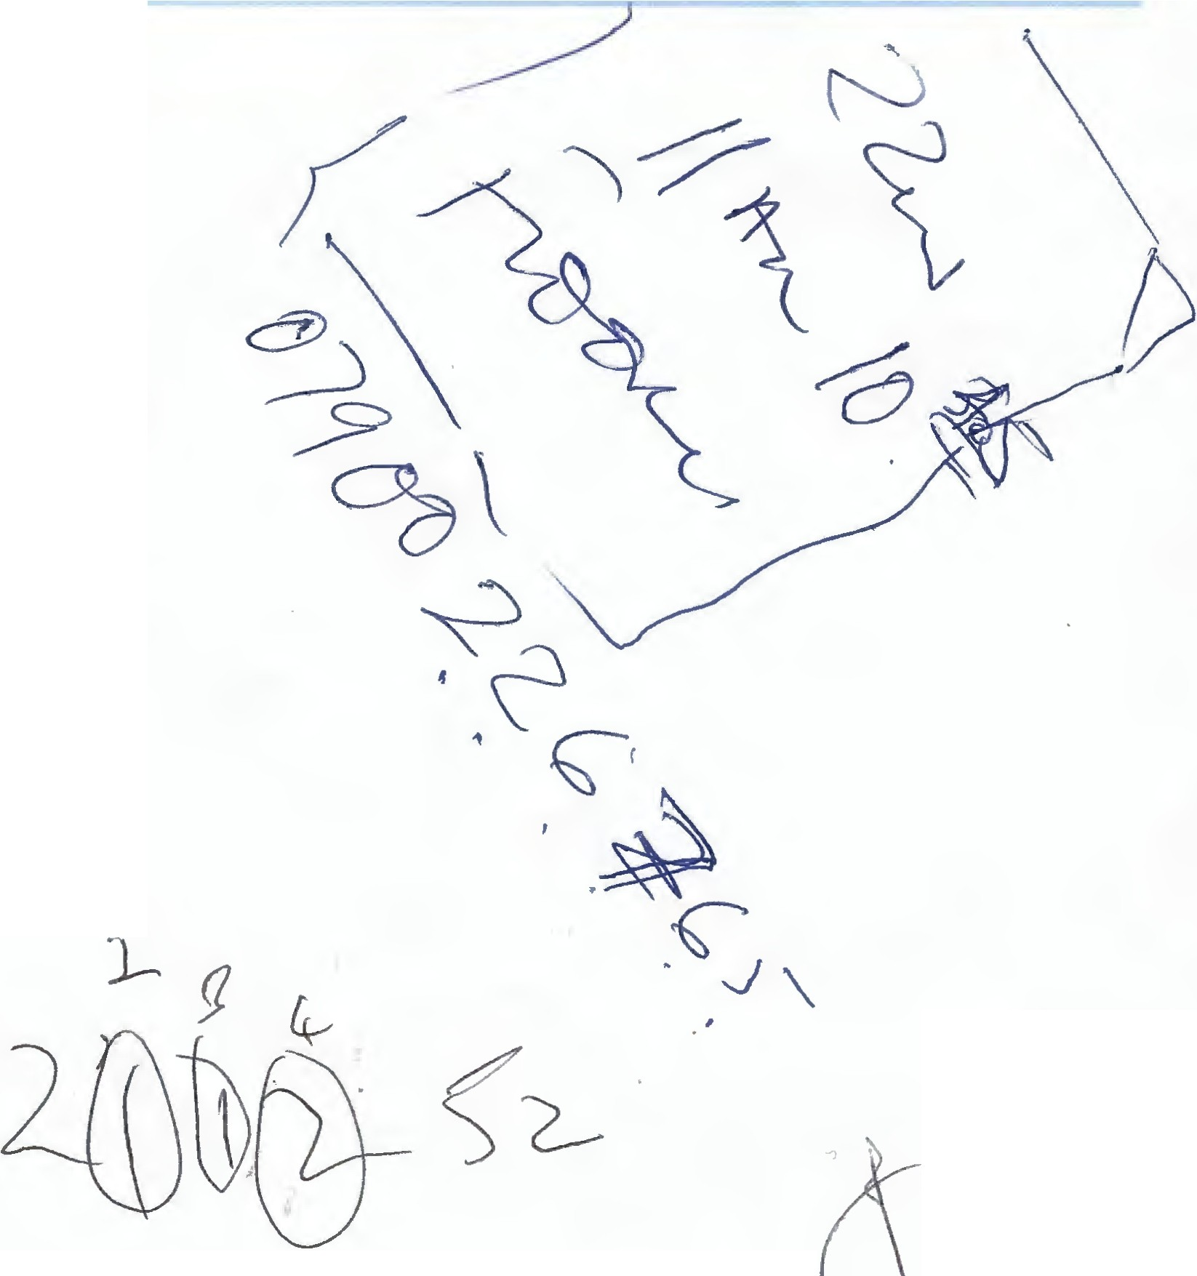
Summary and Learning Outcomes
Congratulations! Having completed this module you should be able to:
Describe relevant legislation.
Recognise the different types of medication. Define roles and responsibilities.
Describe relevant techniques for administering medication.
List considerations when recei ving , storing and disposing of medication.
Identify the rights of an individual.
Describe suitable recording and reporting techniques relevant to medication administration.
This module has been designed to meet the knowledge requirement of the Diploma in
1
Health and Social Care Unit: Support the use of medication in social care settings (QCF HSC
-
3047). In order to achieve credits towards the diploma you will need to be observed applying this knowledge in your practice and complete diploma assessment questions.
Having completed your module, you should be able to satisfy the learning outcomes outlined here.
---
2 724--

